Slide 1


Social Media fake news detection
1

Slide 2
Problem statement
The abundance of information on the internet, especially through social media, has led to a surge of fake news. This spread of false information threatens public perception, decision-making, and democratic societies. Manually verifying the vast amount of online content is impractical and time-consuming. Thus, an automated system to distinguish between real and fake news is essential to provide users with accurate information
The project aims to contribute to media literacy by providing users with a tool that facilitates critical analysis of news articles. By promoting awareness and informed decision-making, the system will empower individuals to navigate the digital information landscape with confidence, fostering a more vigilant and discerning society
goal
2

Slide 3
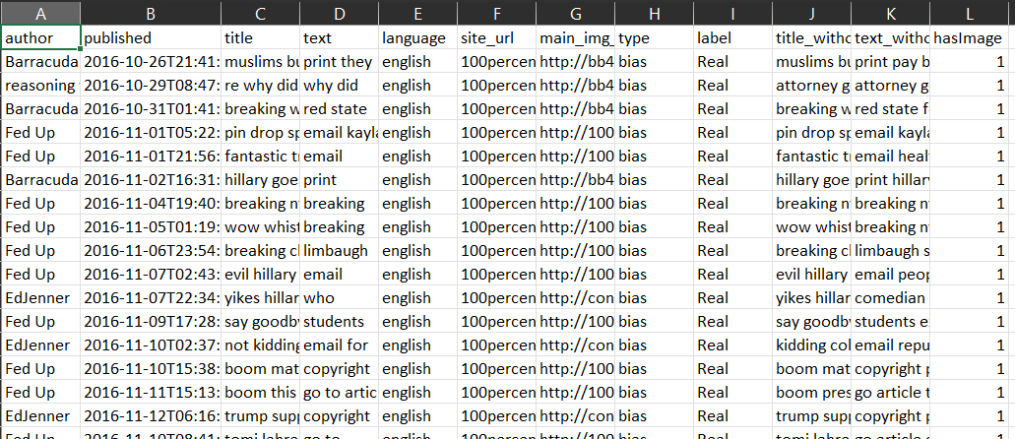
DATA description
Author: Name of the person who authored the article.
Published: Timestamp when the article was published.
Title: Headline of the article.
Text: Main body of the article.
Language: Language in which the article is written
Site_url: Website address where the article was published
Main_img_url: Web address of the main image in the article
Type: Category of the article (e.g., bias, fake, etc.).
Label: Designation of the article as "Real" or "Fake."
Title_without_stopwords: Title text stripped of common words
Text_without_stopwords: Main text stripped of common words
Hasimage: Indicator if the article includes images (1 for yes, 0 for no).
DATA description
Raw Data
3

Slide 4
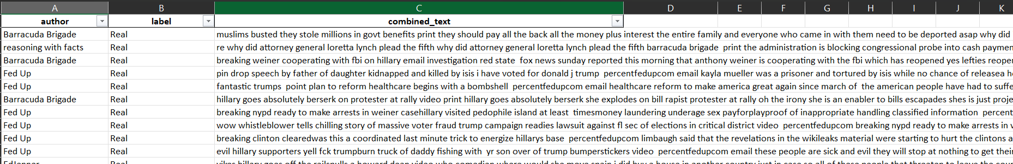
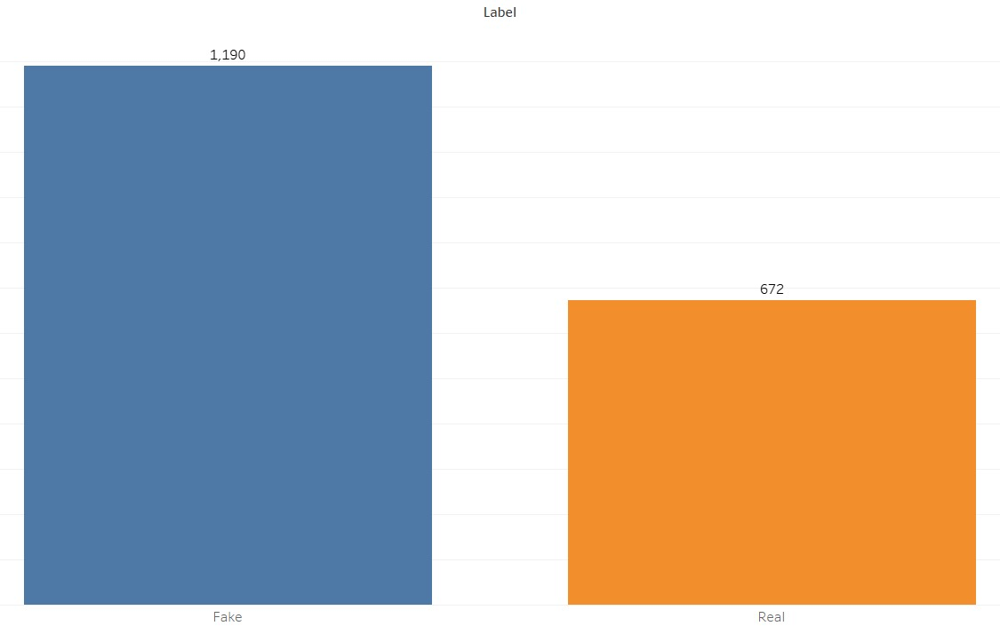
Dataset overview and split
Processed Data
Dataset: 2097 records obtained from kaggle.
Random Sample: We cleaned the data and obtained 1863 records, which we will use for the analysis and model development.
News Distribution: Out of the 1863 records, 672 are Real news and the remaining 1190 records are Fake news.
Data Split: Utilized a 50% training, 30% validation, and 20% testing split for model training and evaluation.
4

Slide 5
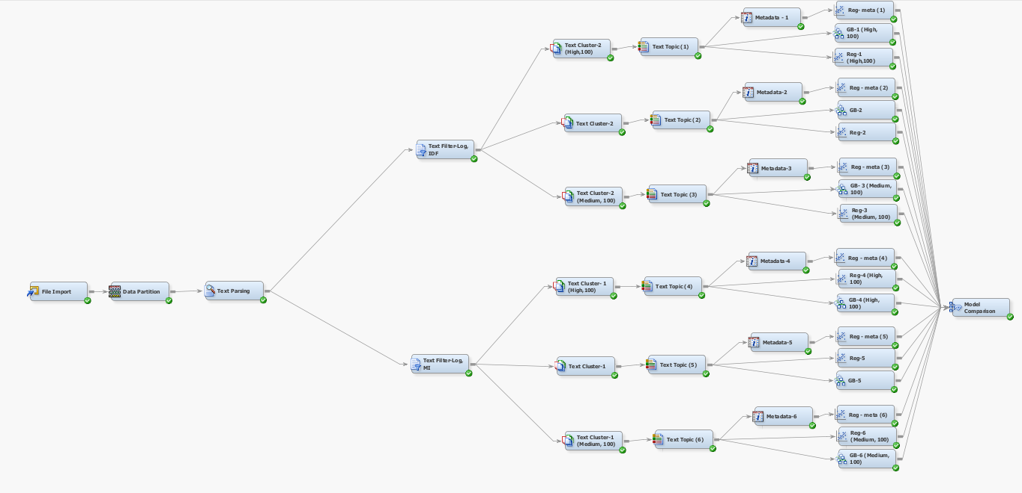
Final model diagram
5
Notes:
We have experimented using different svd dimensions, text topics and various supervised learning techniques
During text parsing we went with default stop list
We used different term weights like idf, mutual info and inverse.
If we have a target variable, we had gone with mutual information

Slide 6
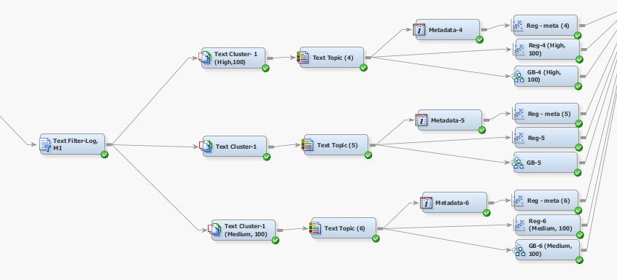
Using term weight as mutual information
SVD values | Model Type | Test: ROC Index
High, 100 | Regression | 0.824
 | GB | 0.817
Low, 100 | Regression | 0.821
 | GB | 0.809
Medium, 100 | Regression | 0.829
 | GB | 0.819
6
Notes:
We used different term weights like idf, mutual information and inverse.
Since, we have a target variable, we have gone with mutual information.

Slide 7
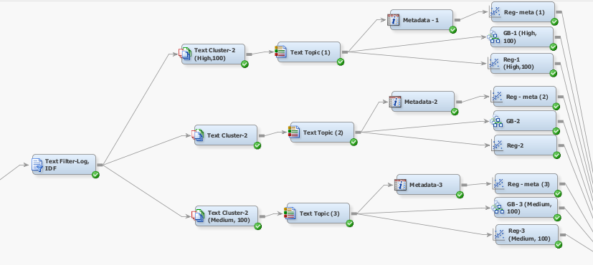
Using term weight as idf, Freq weighting as log
SVD values | Model Type | Test : ROC Index
High, 100 | Regression | 0.784
 | GB | 0.797
Low, 100 | Regression | 0.788
 | GB | 0.777
Medium, 100 | Regression | 0.794
 | GB | 0.775
7
Notes:
After performing Mi, we wanted to check another weighted model as well.
In text filter, we experimented frequency weighting with both binary log and non, we got best with log.

Slide 8
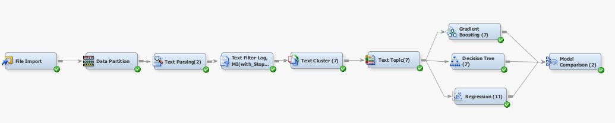
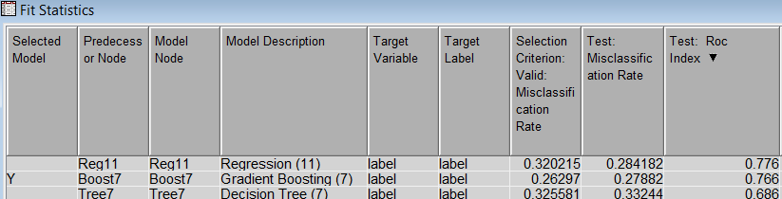
Stop words and their significance
Stop Words: Words that are excluded from analysis as they have high or low frequencies within the given records
Purpose: Eliminating stop words helps improve the accuracy and reliability of the analysis
Additional Stop Words: We have tried a model using a new stop list that is created where the words that are in less than 10 documents and more than in 450 documents are present
8

Slide 9
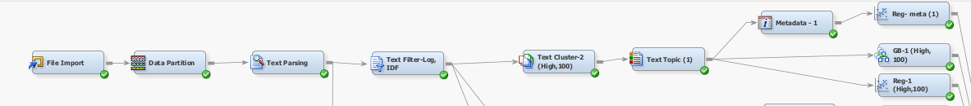
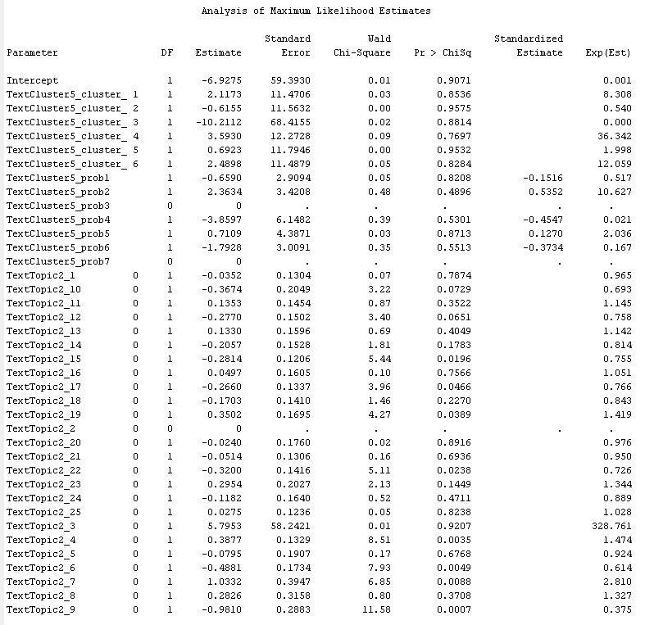
Interpretable model
Excluded SVD inputs and raw text topic from analysis due to potential interpretation challenges.
Focused analysis on text topic and text cluster_probability as key variables for the study.
Model Description | Test: ROC Index | Test: Misclassification Rate
Reg-Meta(1) | 0.721 | 0.329
9

Slide 10
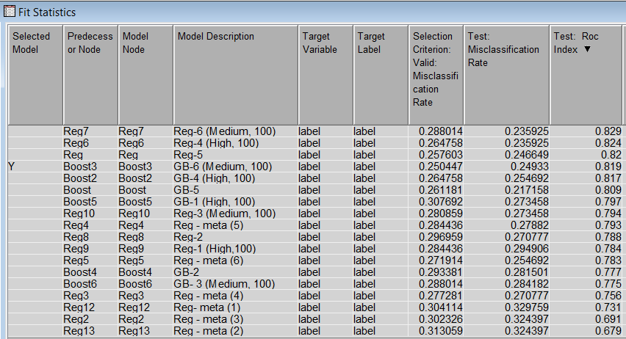
Final model comparisons
10

Slide 11
Best model
Model | Model Description | Test: ROC Index | Test: Misclassification Rate
Regression | Regression 6, Med 100 | 0.829 | 0.235
For models with binary outputs, ROC is the selection parameter, we have determined that "Regression-6 (Medium, 100)" stands out as our best-performing model
11

Slide 12

Conclusion
The model reveals specific predictors that have a substantial impact on the dependent variable.
Positive predictors TextTopic7_raw6 is the type of topic which show real news.
Negative predictors TextTopic7_raw14 is the type of topic which show fake news.
12

Slide 13
Business Insights
Demand for Reliable Information:
The rising concern over fake news underscores a growing demand for reliable information sources.
Businesses and individuals are increasingly seeking tools to verify the authenticity of online content.
Data-Driven Decision Making:
By using data mining techniques, the project showcases the importance of data-driven decision-making in tackling complex societal issues.
Potential Market & Applications:
There's a potential market for such tools among news agencies, social media platforms, and educational sectors.
The technology could be integrated into social media algorithms to flag or filter fake news content.
13

Slide 14
Thank You
14

